Slide 1
POCKET EYEcare Smart Small Application FOR THE DRUG STORE
MR.Suttipong kullawattana
MISs.Titichaya Ratmangkornsakul

Slide 2
Summarize your product offer
EyeCare Monitoring with 5R Process is Right Person, Right Drug, Right Dose, Right Route, Right Time.

Slide 3
Summarize your product offer
1. Submit the required drug information. (OCR Image Recognition).
2. Recorded health information with voice terminals from the disabled. (Speech Recognition).
3. Alert and send notification system (Firebase Notification).

Slide 4
Describe the problem your product is solving (facts please, no marketing-speAk)
Medication is essential to living. But it can cause a terrible penalty if used incorrectly. The problem of drug insecurity of Thai people is common allergy medication drug deterioration. Overdose or to get a dose of inappropriate drugs, such as more or less, and the use of drugs not so well with the disease, etc. These problems. Part of this may be due to misunderstandings and improper drug behavior of the patient itself. The patient's insecurity can be caused by the health system and the inadequate pharmacy services especially the provincial hospital. Due to the current lack of capacity of pharmacists in the hospital.
If you go back 15-30 years ago, the role of the pharmacist is only to order the warehouse, dispensing and production work, but at present. The role of the pharmacist has changed. To be in charge of the drug safety system together with other professions such as outpatient pharmaceutical care. Inpatient Pharmacy Care At present, hospitals are developing to obtain Hospital Accreditation (HA).
In addition to the patients in the health insurance system. The page has access to the service conveniently and is expected to receive quality medical care. So it is clear that the current workload is much higher than in the past. Health professionals such as doctors, dentists, nurses, pharmacists are stressed in their work and are very responsible.

Slide 5
Describe your solution
1. Submit the required drug information. (OCR Image Recognition) for need to know the properties of the drug to take medicine to match the symptoms.
2. Find the medication you need and meet the symptoms of the disease and recorded health information with voice terminals from the disabled. (Speech Recognition).
3. Reduce travel problems to the hospital with Alert and send notification system.

Slide 6
Describe your solution
1. Need to know the properties of the drug to take medicine to match the symptoms.
2. Find the medication you need and meet the symptoms of the disease.
3. Reduce the use of drugs.
4. Reduce travel problems to the hospital.
5. Reduce the risk of complications from chronic illness.

Slide 7
Process 1: Login System Patient side (Beginning Process of Using EyeCare Application)
- Step 1 : The patient creates a history of Algorithm to determine the patient's drug use.
- Step 2 : Login to access the patient's application and check the patient's history.

Slide 8
Process 2: Patient Side
- Step 1: Save your health information. The system will create Calendar and Timeline.
- Step 2: Send the required drug information with OCR Image Recognition.
- Step 3:
3.1 Check health information according to checklist for regular people.
3.2 Record health information by voice. For the disabled (Speech Recognition).
- Step 4: Send Notification, Email and Data from Submit System (Firebase Notification).

Slide 9
Process 3: Hospital Side (Ending Process of EyeCare Application)
Doctors Get Notification, Notification and Information System (Firebase Notification).
- Step 3: Printing data according to the Notification received from the patient.
- Step 4: Order prescription drugs and check Barcode.

Slide 10
How is your solution different to an existing one
1.The patient creates a history of Algorithm to determine the patient's drug use.
2.Send the required drug information with OCR Image Recognition.
3.Send Notification, Email and Data from Submit System (Firebase Notification).
4.Order prescription drugs and check Barcode.

Slide 11
How are you planning to make money? Who is your customer?
1. Presenting a project for funding through the Thailand Tech Startup Association
2. Point of Sale In the first phase, open to use. We will look at the market step by step in one module, by the grade of the product will be set to three levels, Gold, Silver, Premium, and will be open 30-day trial, which will see the market every 3-6 months. Which module do you use? And how to use the problem? By allowing users to report problems by using the solution back to the support team.
3. Making R&D to improve product quality every 3 years.
4. Average sales growth is at least 30% per year.

Slide 12
Discuss Impact of Solution on Community/ Competitive Solutions
It saves information on the device that is with us almost always. We can easily find our own health information / history.
Schedule data access from outsiders. Or security does not provide health information. This is our personal information. Spill to the unwanted person. Or those who aspire to business.
Applications that need to be easy to understand. Can save data easily. And users can easily browse the information as well.
Assignment of access rights to information such as pharmacists in general pharmacies with physicians. Or specialized doctors we should have access to our health information at a different level.

Slide 13
Discuss Business Viability of Application
Reduce the history checking process with face detection.
Reduce shock problems with illnesses such as heart disease and pressure with fingerprints.
Reduce the problem of overdose. Enhanced drug delivery system, check medication, prescription drug delivery drug information, reduce drug errors, repeat the drug. And add drug-based behavior as defined by the pharmacist, line guide, navigation and E-mail.

Slide 14
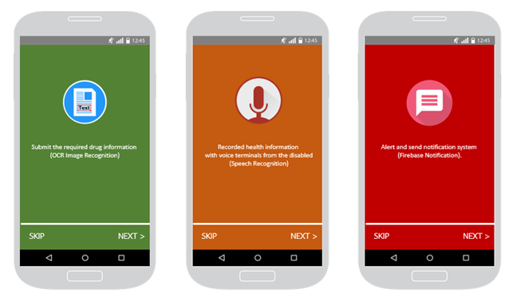

Slide 15
Forms for patients to fill in a separate disease and other diseases
1. Medicine Name
2. Drug Registration Number (Reg.No).
-1A : The drug produced in the country.
-1B : Imported drugs and ordered from abroad.
-1C : Imported drugs from the various parts shown at the end of the language is the number of engravings that have been registered for drug registration and override end number of year To be registered. For example 1A 12/45, 1B 3/49, 1C 30/49 etc. For drug formulations containing two or more essential drugs, the drug registration number will begin with 2A, 2B, 2C then followed by the sequence and the end number of the year. BC registered.
3. The amount or size of the medicine. (Number of drugs (Milligrams))
4. Numbers or alphabets produced or analyzed. These are often abbreviated as Lot No., Cont.No., Batch No. or L, C, L / C, B / C.
5. Name and location of the manufacturer.
6. Start Date to produce of Drug and Expired Date of Drug.
7. The term dangerous drugs, special control drugs, topical or topical medications.
8. How to take medicine.
9. Side effects of medications and warnings.
10. Information on drug allergy.

